Slide 1

Introduction to Computer Systems
Operating Systems 2
Direct Link to view these slides on Google Docs

Slide 2
What to expect in this topic:
Operating concepts:
Kernels
Processes
Memory
Files
The shell

Slide 3
A Computer
Operating System
CPU
RAM
Monitor
OS
Flash Memory
Keyboard
Printer
Disk CD/DVD
Mouse

Slide 4
OS Concepts
Kernel
Processes
Deadlock
Scheduling
Memory
Files
Security
The shell

Slide 5
OS Concepts
A kernel (core) provides access to the computer hardware and controls access to resources.
e.g.
The kernel decides who will use a resource, for how long and when.
Kernel itself is useless unless you get all the applications such as text editors, email clients, browsers, office applications, etc.
Kernel
Processes
Deadlock
Scheduling
Memory
Files
Security
The shell
Hardware: Terminals, Printers, Disks... etc.
H/W
Kernel
Shell
User

Slide 6
OS Concepts
In computing, a process is an instance of a computer program that is being executed.
It contains the program code and its current activity. Depending on the operating system (OS), a process may be made up of multiple threads of execution that execute instructions concurrently.
Kernel
Processes
Deadlock
Scheduling
Memory
Files
Security
The shell
Program
Input
Process
Output
Storage

Slide 7
Processes
A program in execution (program code and its current activity).
0xFFFFFFFF
stack
data
address space or core image
text
registers: global pointer, stack pointer, etc.
Processes are interrupted and restored.
A process table is an array of structures one for each process.
Processes can create other processes and communicate between them.
OS
0

Slide 8
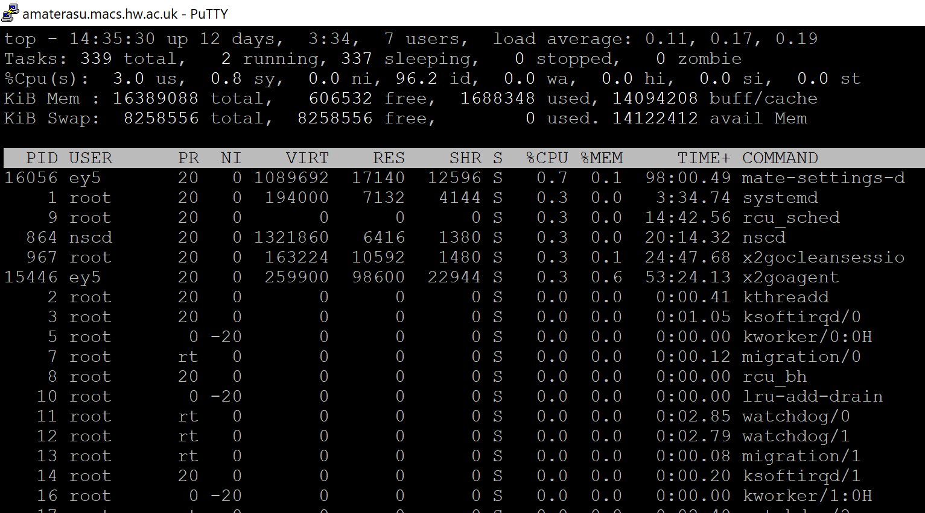
Processes
This is a screenshot of the result of a top command in linux.
It shows the processes currently being used with additional information about the computer’s state.

Slide 9
OS Concepts
Kernel
Processes
Deadlock
Scheduling
Memory
Files
Security
The shell

Slide 10
Processes: Deadlock
Waiting for X
Resource
X
Owned by B
In an operating system, a deadlock occurs when a process or thread enters a waiting state because a requested system resource is held by another waiting process, which in turn is waiting for another resource held by another waiting process.
Process A
Process B
Resource
Y
There exists a cycle of processes such that each process cannot proceed until the next process takes some specific action. Result: all processes in the cycle are stuck!
Owned by A
Waiting for Y
A deadlock is a situation in which two computer programs sharing the same resource are effectively preventing each other from accessing the resource, resulting in both programs ceasing to function.
The earliest computer operating systems ran only one program at a time !!!
A state is safe if the system can allocate all resources requested by all processes ( up to their stated maximums ) without entering a deadlock state.

Slide 11

Processes: deadlock
Process 1 Process 2
Tape CD-recorder

Slide 12
OS Concepts
Kernel
Processes
Deadlock
Scheduling
Memory
Files
Security
The shell

Slide 13
Process Scheduling
Operating System responsible for deciding which process to execute
Process states:
Ready
I/O finish
Blocked
Schedule
Time slice
end
I/O start
Running

Slide 14
Memory management
More than one process can be active in RAM.
0xFFFFFFFF
stack 1
stack 2
Virtual memory complicates picture
data 1
But also makes it simpler!
text 1
data 2
text 2
OS
0

Slide 15
Memory Management
Operating System
Operating System
Process 7
Internal fragmentation
Process 0
There is enough memory to run process 7 but the memory is not contiguous (in sequence)
Job A
Process 6
Process 2
Job C
External fragmentation
External fragmentation
Process 5
Process 4
Job F
Process 3

Slide 16
OS Concepts
Kernel
Processes
Deadlock
Scheduling
Memory
Files
Security
The shell

Slide 17
Files
Whenever a process is loaded or removed from the physical memory block, it creates a small hole in memory space which is called fragment.
Files – long term storage for data and programs
Stored on mass storage (e.g. disk)
Disk allocated to files in fixed size blocks
Even a 1 byte file will use a whole block of disk
Always have unused space at end of last block
Internal fragmentation
Initially file is set of contiguous blocks (ideally)
As edited, extra blocks added – not contiguous with original
External fragmentation
Program A
Program B
Block 1
Unusable Space (Internal fragmentation)
Program C
Block 2
Free Partition

Slide 18
Files
Files – long term storage for data and programs
Meta-information
Name
Owner
Size
Dates
Access permissions
File type (?), hidden, archive, etc bits
Meta-information may be in
Directory – special format file accessible to user
Catalog – hidden file used by OS

Slide 19
OS Concepts
Kernel
Processes
Deadlock
Scheduling
Memory
Files
Security
The shell

Slide 20
File System Security
Integrity of file system is very important to OS
Crashes should not corrupt structure
Include redundant structures so that system can be reconstructed
File meta-information may restrict access to file
Read only
Read/write
Execute
Selected users/programs may have different rights

Slide 21
OS Concepts
Kernel
Processes
Deadlock
Scheduling
Memory
Files
Security
The shell

Slide 22
The Shell
In computing, a shell is a user interface for access to an operating system's services.
In general, operating system shells use either a command-line interface (CLI) or graphical user interface (GUI), depending on a computer's role and particular operation.
External face of OS – not part of OS
Users interact with shell to start processes
Originally command line interface (CLI)
Allows programs to be executed and parameters to be passed to them
Desktops
Files can be dragged and dropped onto applications
Applications automatically associated with files
Kernel
Operating System
Shell

Slide 23
Operating Systems Summary
OS is resource manager
Controls access to peripherals
Shares resources between processes
Complex algorithms
Scheduling
Deadlock prevention
File system maintenance

